Slide 1
COVID-19 in Africa – Policy Priorities to Safeguard the Demographic Dividend
Bernard Onyango, PhD.
Senior Research and Policy Analyst, AFIDEP
May 6, 2021

Slide 2
Overview
Background and objectives
Morbidity and Mortality from COVID-19 in Africa
Impact of the pandemic on various sectors
Key recommendations

Slide 3
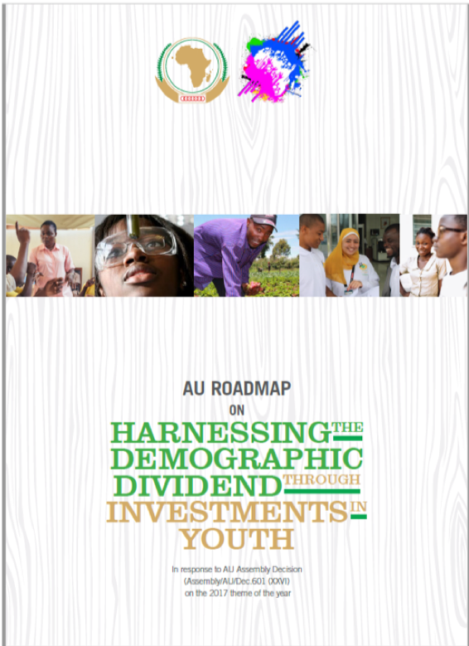
Background
Compared to the rest of the world, Africa is youthful. The United Nations (UN) estimates that 60% of Africa’s population is under 25 years of age compared to a global average of 41%.
The region can capitalise on this youthful population to benefit from the Demographic Dividend (DD).
Notes:
It is the economic benefit arising from a significant increase in the ratio of working-age adults relative to young dependents.
When birth rates decline significantly, the age structure shifts in favor of more working-age adults, which can help accelerate economic growth through increased productivity, greater household savings, and lower costs for basic social services provided to children
The DD is not guaranteed by the shift in age structure alone but must be accompanied by investments in human capital development (health; education and skills) and promoting an enabling environment that provides opportunities for decent jobs

Slide 4
Objectives and Methods
Develop policy recommendations that African countries can adopt now and in the post-pandemic period to safeguard the DD.
Synthesis of deliberations at webinar series
Rapid assessment
Notes:
Five part webinar series to create a space for sharing a demographic perspective on the impacts of COVID-19 with partners on the continent, considering its implications for Africa to reach a demographic dividend and achieve the SDGs.

Slide 5
Partners
Department of Social Development (DSD), South Africa - Lead
Statistics South Africa
British High Commission to South Africa and the Foreign, Commonwealth and Development Office (FCDO)
UNFPA East and Southern Africa Regional Office
African Union (AU) and Africa CDC
African Institute for Development Policy (AFIDEP)
Union of African Population Studies (UAPS)
Population Association of Southern Africa (PASA)

Slide 6
Key questions
How do demographic age structures and indicators influence the way COVID-19 spreads in and affects a population?
What has been learnt about data, indicators and the measurement thereof to monitor and evaluate the impact of COVID-19 and to inform governments’ responses?
What are the possible implications of the COVID-19 pandemic on progress towards a positive and inclusive demographic dividend in Africa?
What lessons can we learn from Africa’s response to COVID-19?

Slide 7
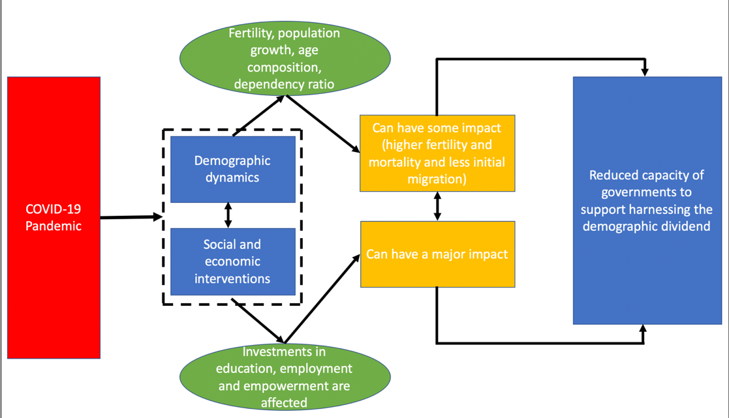
Possible impact of COVID-19 on the DD
Summarized conceptual framework for main effects on Africa’s DD
Source: Adapted from presentation by Jose Manuel Guzman (2020)

Slide 8
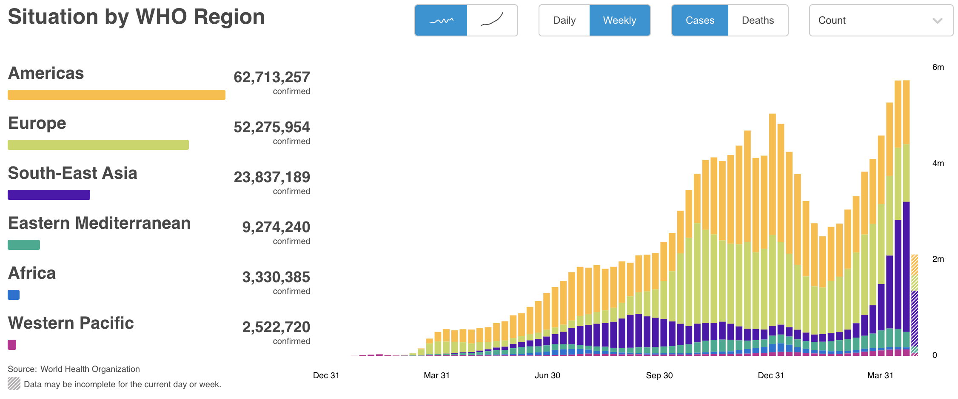
Fewer reported cases……
Notes:
Optimism and concern for Africa at the beginning
Would Africa’s relatively young population provide a protective shield?
Would higher prevalence of infectious diseases such as HIV/AIDS compared to other world regions put it at higher risk than the rest of the world?
Would weak health systems in the continent cope or be overwhelmed?
Will the climate have an impact?

Slide 9
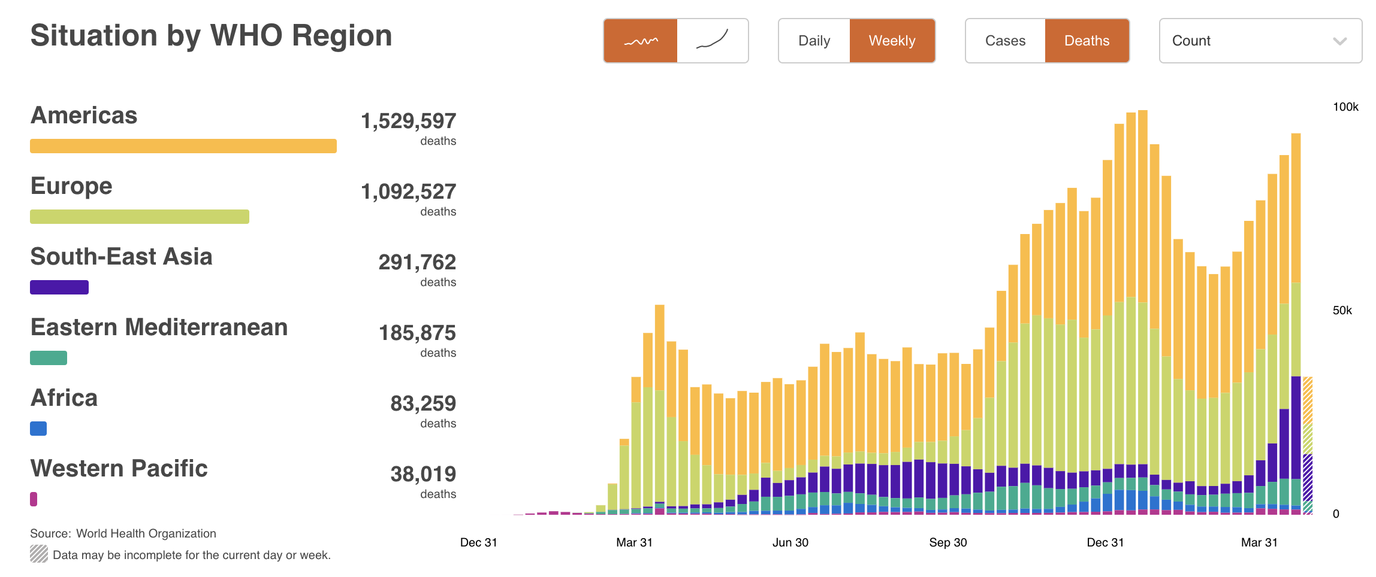
…and deaths in Africa. So far.

Slide 10
Key measures by African governments to control the pandemic
Public health measures on hygiene including measures to improve hand-washing and mandating the use of face masks.
Mass screening and testing.
Social distancing and limiting public gatherings.
Closure of schools and training institutions.
Movement restrictions within countries ranging from night-time curfews, partial lockdown and national lockdowns.
International travel restrictions including full border closures and international air traffic closures.
Notes:
With the unknown consequences of the pandemic looming, and numbers of cases and deaths spiking, first in China, then Europe and North America, governments in Africa started to take serious measures to control the pandemic between March and April, 2020.
Some of the most stringent measures have since been relaxed or halted as the situation seemed to get under control while others have been re-introduced with the threat of a second wave of the pandemic.

Slide 11
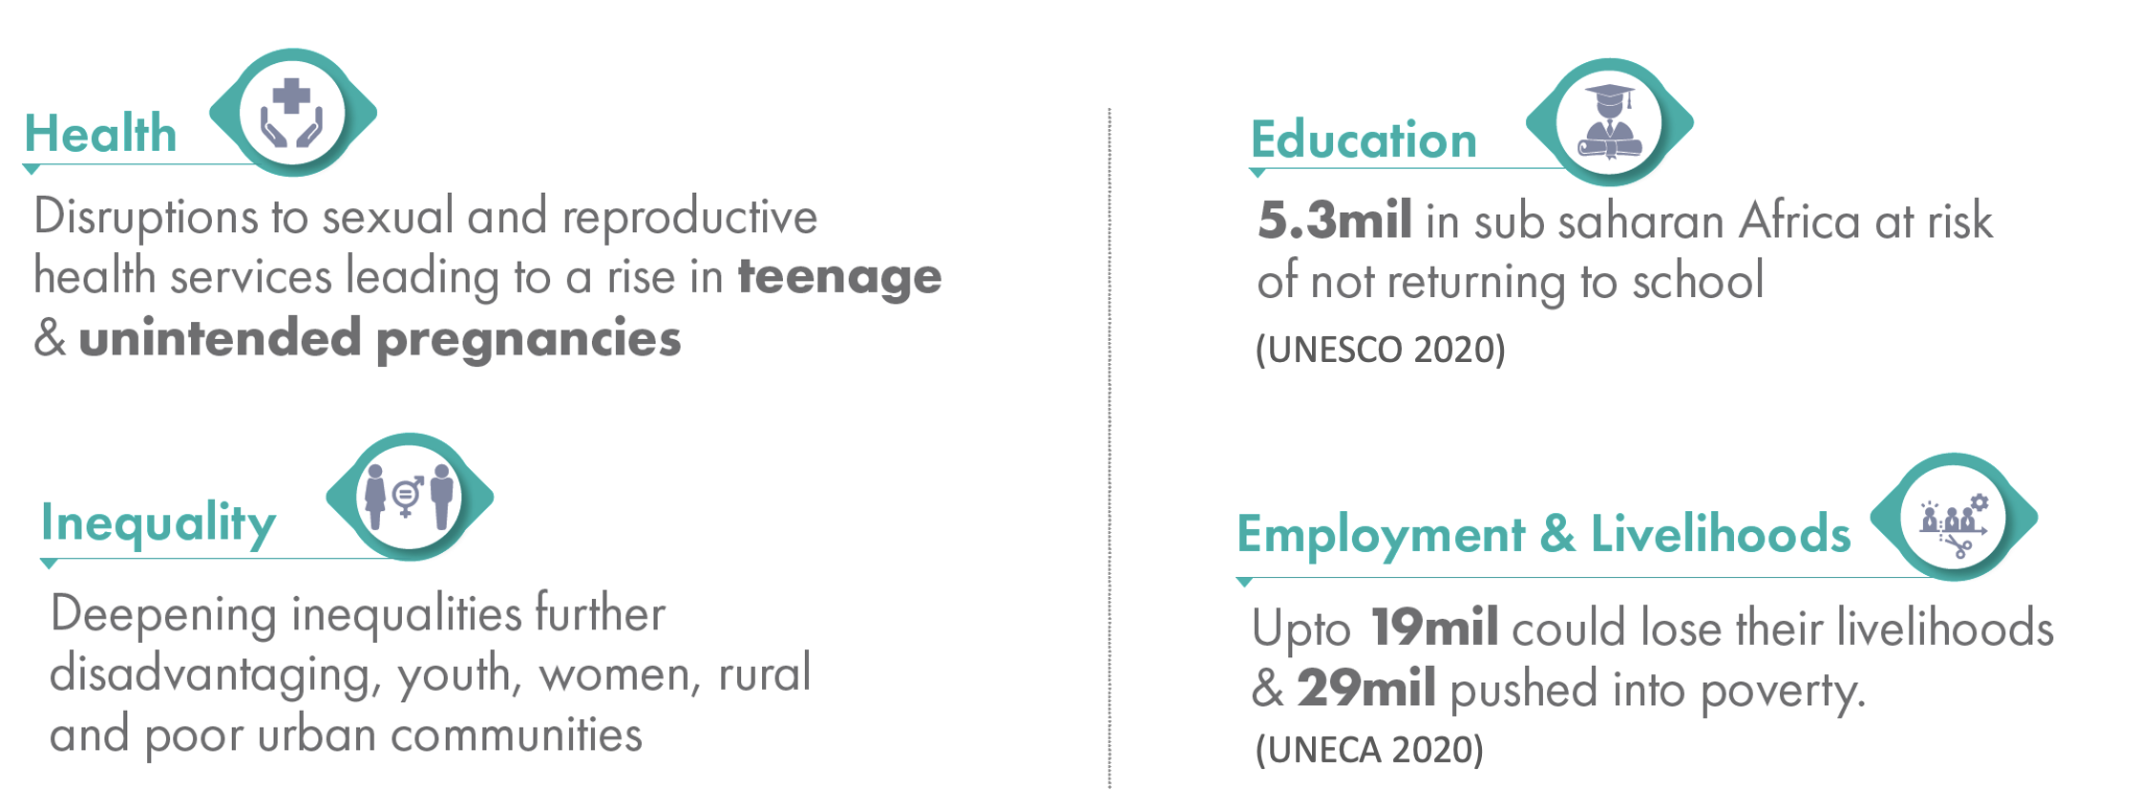
Key Drivers of the Demographic Dividend Under Threat

Slide 12
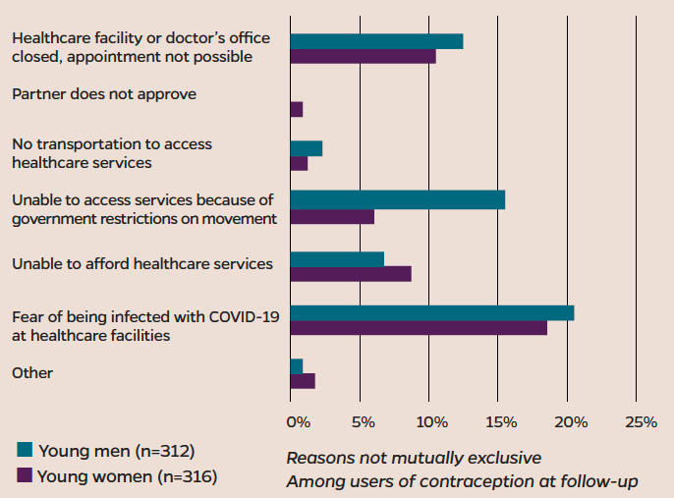
Reproductive Health in Kenya
Disruptions to contraception for adolescents and young adults (age 15-24) in Nairobi during the pandemic
Source: PMA Agile/Gender and ICRHK (2020)

Slide 13
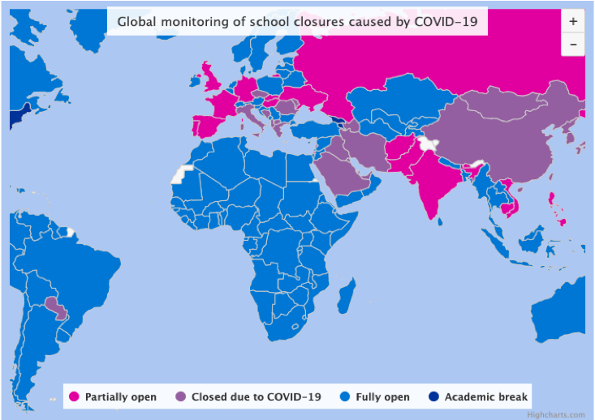
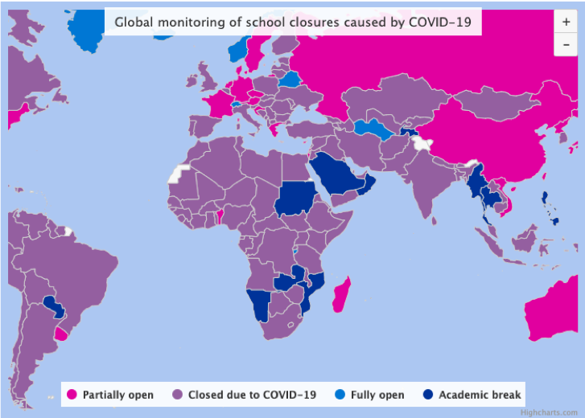
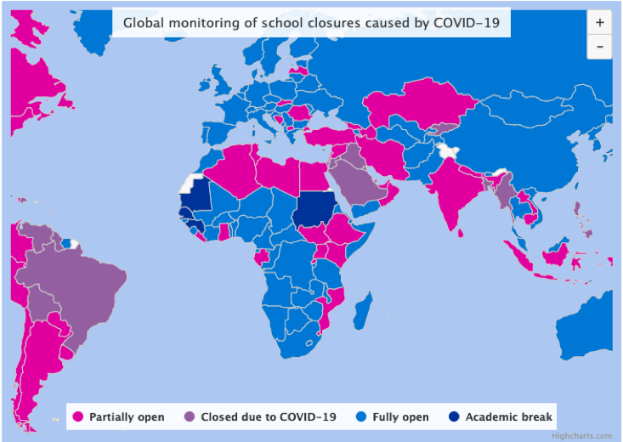
Education and training has been massively disrupted
March 10, 2020
May 10, 2020
November 10, 2020
Source: UNESCO
Notes:
The consequences of closure of schools and other training institutions have notable potential to undermine the development of human capital required to harness the demographic dividend. Not only will there be long-term impact on learning outcomes but it is very likely that a lot of young people will indefinitely drop out from the education system

Slide 14
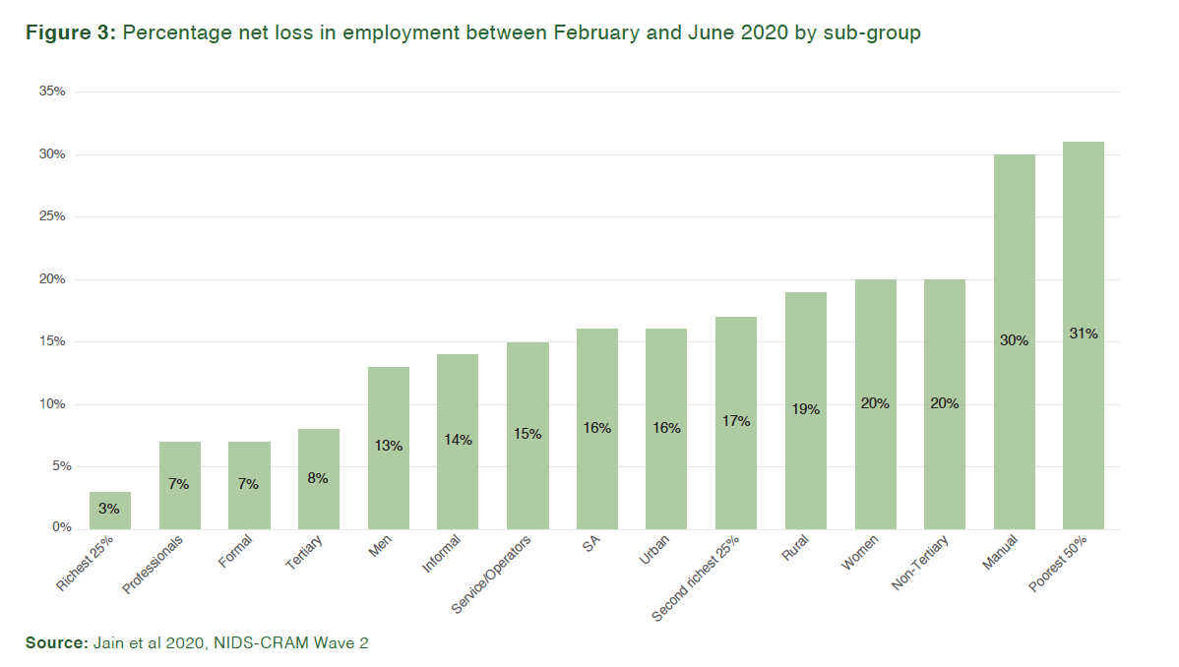
Example from NIDS_CRAM Study in South Africa
Percentage net loss in employment between February and June 2020 by sub-group
Notes:
Data from Stats SA show for example that 2.8 million jobs lost between February and April 2020 had not returned by June. Moreover, impact of the loss in employment was felt most by poor, rural, female, unskilled and less experienced persons (Figure 6). The poorest 50% of workers and manual laborers for example, were ten times more likely (31% net loss) to lose their job between February and June compared to the richest 25% of workers (3% net loss). Informal workers were twice as likely to lose their jobs (14%) compared to formal sector workers (7%).

Slide 15
Recommended Policy Priorities

Slide 16
1. Sexual and Reproductive Health and Rights (SRHR) and Gender-Based Violence (GBV)
Invest in ensuring that comprehensive SRHR services are adequately funded and there is full resumption of services including family planning, adolescent sexual and reproductive health services and youth friendly services.
Funding and programmes should be monitored to ensure continuity of SRHR as part of the essential health services during the pandemic.
Design effective interventions to reinforce adherence to existing laws to protect girls and women from SGBV.

Slide 17
2. Education and Training
Implement robust return-to-school strategies, with a particular focus on ensuring that the disadvantaged groups as well as girls do not drop out of school.
Prevent deepening learning inequalities, where home-schooling and Open Distance and eLearning strategies have been adopted to ensure continuity of learning.

Slide 18
3. Employment, Livelihoods and Social Protection
Invest in re-igniting the informal and gig economies.
Provide inclusive social protection measures such as cash transfers, food subsidies, and free medical care.
Deploy evidence-based targeting of programmes.
Monitoring and evaluation mechanisms to improve the effectiveness of these programmes.

Slide 19
4. Data and Measurement
Develop measures to ensure continuation of collection of routine and survey data.
Strengthen routine and survey data collection mechanisms to enhance understanding of the health and socio-economic impact of COVID-19 and improve monitoring and evaluation of COVID-19 intervention programmes.
Conduct in-depth assessments of the impact of COVID-19 on population inequalities to draw actionable recommendations.
Build on existing longitudinal evidence generation platforms such as the Health and Demographic Surveillance Systems (HDSS) to generate evidence.
Promote the use of alternative data collection models including the adoption of various technologies for data collection.

Slide 20
5. Leveraging Digital Technologies
Invest in enhancing the development and use of digital technologies that have been critical across sectors in the prevention and recovery measures.
health services
digital learning platforms
e-commerce

Slide 21
6. Strengthening Multi-sectoral Action
Leverage on regional integration and continental collaborations, building on ongoing efforts by the African Union Commission (AUC), Africa CDC and regional economic blocs.
Sharing of best practices on prevention and response to build back better.
Investing on developing a dedicated evidence and knowledge-hub that will address COVID-19 and the Demographic Dividend in Africa.

Slide 22
Protecting the vulnerable
Vulnerable groups require special attention during the response to COVID-19 as they have been disproportionately affected and even the responses in place against the effects of the pandemic do not adequately reach them.
The poor
Women
Youth
Notes:
On the SRHR front, young girls have to be protected from dropping out of school since this is likely to lead to teenage pregnancies and child marriages that will curtail their future potential.
Women have been exposed to increased SGBV during this period and measures need to be put in place to protect and support them.
Interventions using digital platforms, including digital learning have clearly illustrated the digital gender divide that will need to be addressed.
The loss of employment has disproportionately affected the poor, youth and women who are more likely to be employed in the low-earning informal sector jobs with no social protection measures.
Noting that Africa has a youthful population, it would appear that COVID-19 has further deepened the existing barriers that have held them back from reaching their full potential and especially so in developing their human capital. If not addressed, this will probably be the biggest set-back from the pandemic on the continent’s ability to harness the demographic dividend.

Slide 23
Thank You
Visit https://www.afidep.org/pub_type/demography-and-covid-19-in-africa/ for the webinar series resources including the report and infographics

